Slide 1
Mantid Development introduction
Nick Draper
11/04/2008

Slide 2
Agenda
Why do we need Mantid?
What will Mantid do?
Progress so far
Plan for the future
Questions

Slide 3
Why do we need Mantid?
Previously different tools were used on the different beamlines.
  PC Collette, Ariel, SXD2000, OpenGenie, LibISIS.
  Confusing for users.
  Replicated effort across the tools.
  Difficult to support.
Mantid
  To standardise data reduction tools between instruments.
  To improve the support and documentation for the tools.
  To handle the expansion of data volume.
  While having the flexibility to be extended by scientists as required.

Slide 4
What will Mantid do?
Mantid
  Manipulation and Analysis Toolkit for ISIS Data
Aims
  To provide a framework for Data Analysis that is not instrument or technique/dependent.
  To support multiple target platforms (Windows, Linux).
  The framework must be easily extensible by Instruments Scientists/Users.
  The framework must be freely redistributable to visiting scientists.
  The framework should provide low-level functionalities for Scripting, Visualization, Data transformation, Implementing Algorithms, Virtual Instrument Geometry.

Slide 5
What will Mantid do?
Scope
  Data reduction and analysis, not Instrument Control.
  Creation of an extensible framework.
  Creation of a command line and scripting interface.
  Creation of a Visualization tool.
  Creation of a repeatable automated test environment.
  Provision of user and support documentation.
  Providing user support for usage and extension of the framework.
  Creation of specific beamline interfaces as required. (Later)

Slide 6
Top Requirements
Easily extensible.
  Support all current and future analysis.
  Support current and future file formats.
  Provide a simple but powerful objects and services to support user created algorithm code.
No user license costs.
Supportable.
Portable.
  Operating System (Windows, Linux).
  Computing Power (Laptop, Server).

Slide 7
Architectural Design - Overview
Instrument log files
Command line & Scripting interface
Mantid Framework
RAW data files
API
Standard Algorithms
User Defined Algorithms
Visualization tool
NEXUS data files
Future Data analysis GUI

Slide 8
Development Process
Iterative development – Why?
  Adaptability - the ability to rapidly respond to changes in strategy, priorities, and plans
  Value - continuous delivery of more useful functionality
  Visibility - stakeholder collaboration and validation throughout the development life-cycle
  Risk - the reduction in overall project risk as a result of #1-3 above

Slide 9
Development Process
Iterative development.
  Top level aim defined.
  Tasks identified and allocated to fulfill the aim.
  4 week of development and testing.
  Automated tests built alongside all functionality.
  Review, and plan the next iteration.

Slide 10
Software led by Scientists
This is project is intended to support the needs of all of the beamlines.
We need input from each group of instruments
  To ensure what we build fits what you need.
  To ensure good communication between the Mantid project and the scientists.
  To allow each group to have equal input into the project.
To do this we will set up a scientific steering committee.

Slide 11
Scientific Steering Committee
Who?
  The Mantid project manager and one representative from each group of instruments.
What will they do?
  Raise new enhancement requests and report issues.
  Prioritise the list of tasks to be done over the next iterations.
  Review the progress of each iteration.

Slide 12
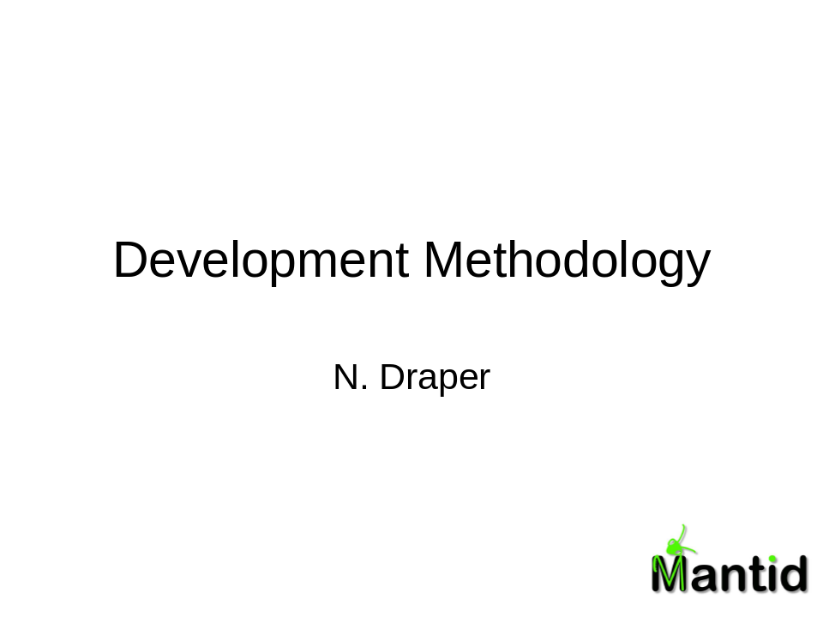
Development Methodology

Slide 13



Development Server Environment
Mantid Project Wiki
SVN
Repository
Linux Build Server
trac
Issue
tracking
system
Windows Build Server
Developers

Slide 14
Team members to contact
Who | Expertise
Nick Draper | Project Manager, windows build server, design questions, requirements clarification, methodology, anything else …
Russell Taylor | Framework internals, eclipse integration
Laurent Chapon | High level geometry, OpenGL visualisation, scientific clarification
Matt Clarke | Python scripting, Linux build server, QTIPlot interface, scons build tool
Freddie Akeroyd | Raw and Nexus files, Wiki/trac, openGenie
Stuart Ansell | Low level surface geometry
Anders Markvarsden | XML Instrument definition
Dickon Champion | History, libISIS

Slide 15
Further Information
Project Web Page
  www.mantidproject.org
Project Introduction Document
  http://svn.mantidproject.org/mantid/trunk/Documents/Requirements/Project%20Introduction%20Document.doc
User Requirements Document
  http://svn.mantidproject.org/mantid/trunk/Documents/Requirements/URD.doc
Architectural Design Document
  http://svn.mantidproject.org/mantid/trunk/Documents/Design/Architecture%20Design%20Document.doc

